Slide 1
EXPENSE ANALYSIS TO IMPROVE SAVINGS
TEAM MEMBERS
THORAM HARITHA NAGA DURGA SINDHU
KALAL RAHUL GOUD
SHAIK HEENA KOUSAR
Yousuf nawab
Jaffer ALI
AF05041412
AF05039572
AF05042620
AF05047409
AF05044937

Slide 2
Problem statement
Nitin works as a Graphic Designer in a new company. He earns RS 15,000/- per month. He is planning to buy a scooter for his daily commute to the office.
For the last couple of months, Nitin is not able to save at all for his scooter. His Friend Ayush told him that he needed to figure out where most of the money goes and cut down that expense.
Help Nitin increase his savings by removing some unnecessary expenses.

Slide 3
Objective of the Project
To track Nitin’s expenses category -wise and month- wise
To identify the highest spending categories
To find non- essential expenses
To provide recommendations to help Nitin save money for his scooter

Slide 4
Task Responsibilities
Part -1
How much is spent for each category (Pivot Table). Visually represent the amount spent against each category is what percentage of the total expense amount (Pivot chart)
How much is spent on different items of each category (Pivot table). Visually represent the amount spent on different items of Entertainment and Ticket and bills category (Pivot Chart)
How many times money has been spent against different items of each category(Pivot Table). Filter the data to display the data for Grocery and shopping items.
What amount is spent on each items of the categories with highest and 2nd Highest Expense amount (Pivot Table). Visually represent the data with data bars (Conditional Formatting).
Part -2
Month-wise trend of expenses ( Pivot table and chart). Find out the month Nithin find the most.
Category wise expenses(Pivot table). Visually represent it with data bars to display categories with the highest and lowest expense amount.
Month- wise expense of each category(Pivot table). Find out 2 categories with higher expenses for each of the 6 months.
How much spent in each month against different items of Entertainment, Food and Shipping categories(Pivot table). Find out which months have the highest amount spent for movies and dining out.
Decide on the essential and less essential items and analyse the expenses. Recommend how can Nitin increase his savings.

Slide 5
Part 1- Problem 1
How much is spent for each category (Pivot Table). Visually represent the amount spent against each category is what percentage of the total expense amount (Pivot chart)
Row Labels | Sum of Expense (INR)
Doctor and Medicine | 450
Entertainment | 1000
Food | 850
Grocery | 4690
Miscellaneous | 500
Shopping | 3500
Ticket and Bills | 2570
(blank)
Grand Total | 13560

Slide 6
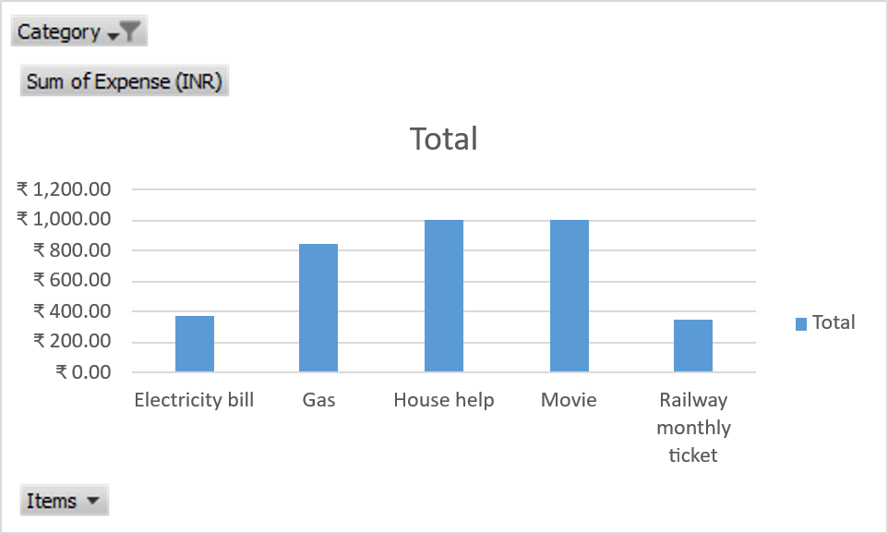
Part 1- Problem 2
How much is spent on different items of each category (Pivot table). Visually represent the amount spent on different items of Entertainment and Ticket and bills category (Pivot Chart)
Category | (Multiple Items)
Row Labels | Sum of Expense (INR)
Electricity bill | ₹ 370.00
Gas | ₹ 850.00
House help | ₹ 1,000.00
Movie | ₹ 1,000.00
Railway monthly ticket | ₹ 350.00
Grand Total | ₹ 3,570.00

Slide 7
Part 1- Problem 3
How many times money has been spent against different items of each category(Pivot Table). Filter the data to display the data for Grocery and shopping items.
Row Labels | Count of Items
Grocery | 15
Beverages | 1
Bread and bakery | 3
Foodgrains and cereals | 1
Fruit | 4
Oil and spices | 1
Vegetables | 5
Shopping | 2
Shoes | 1
Tshirt and Jeans | 1
Grand Total | 17

Slide 8
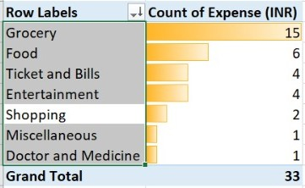
Part 1- Problem 4
What amount is spent on each items of the categories with highest and 2nd Highest Expense amount (Pivot Table). Visually represent the data with data bars (Conditional Formatting).

Slide 9
Part 2- Problem 1
Month-wise trend of expenses ( Pivot table and chart). Find out the month Nithin find the most.
Row Labels | Sum of Expense (INR)
February | ₹ 15,620.00
April | ₹ 14,800.00
January | ₹ 13,900.00
June | ₹ 13,560.00
May | ₹ 13,370.00
March | ₹ 13,140.00
Grand Total | ₹ 84,390.00

Slide 10
Part 2- Problem 2
Category wise expenses(Pivot table). Visually represent it with data bars to display categories with the highest and lowest expense amount.
Row Labels | Sum of Expense (INR)
Grocery | ₹ 30,990.00
Ticket and Bills | ₹ 16,040.00
Entertainment | ₹ 12,000.00
Shopping | ₹ 8,700.00
Miscellaneous | ₹ 7,720.00
Food | ₹ 4,940.00
Doctor and Medicine | ₹ 4,000.00
Grand Total | 84390

Slide 11
Part 2- Problem 3
Month- wise expense of each category(Pivot table). Find out 2 categories with higher expenses for each of the 6 months.
Row Labels | Sum of Expense (INR)
January | 7150
Grocery | 4500
Ticket and Bills | 2650
February | 11800
Entertainment | 7500
Grocery | 4300
March | 8840
Grocery | 6090
Ticket and Bills | 2750
April | 8960
Grocery | 5460
Miscellaneous | 3500
May | 8620
Grocery | 5950
Ticket and Bills | 2670
June | 8190
Grocery | 4690
Shopping | 3500
Grand Total | 53560

Slide 12
Part 2- Problem 4
How much spent in each month against different items of Entertainment, Food and Shipping categories(Pivot table). Find out which months have the highest amount spent for movies and dining out.
Category | (Multiple Items)
Sum of Expense (INR) | Column Labels
Row Labels | January | February | March | April | May | June | Grand Total
Chips and fries | 260 |  |  |  |  | 250 | 510
Dining out | 1000 |  | 800 | 850 |  |  | 2650
Movie | 250 |  | 500 | 250 | 500 | 1000 | 2500
North Bengal Trip |  | 7500 |  |  |  |  | 7500
Online Food order | 640 |  |  | 540 |  | 600 | 1780
Outing with friends |  |  |  | 1000 | 1000 |  | 2000
Shirts | 2000 |  |  |  | 1500 |  | 3500
Shoes |  |  | 1700 |  |  | 1000 | 2700
Tshirt and Jeans |  |  |  |  |  | 2500 | 2500
Grand Total | 4150 | 7500 | 3000 | 2640 | 3000 | 5350 | 25640

Slide 13
Part 2- Problem 5
Decide on the essential and less essential items and analyse the expenses. Recommend how can Nitin increase his savings.
✅ Essential Expenses
These expenses are necessary for Nitin’s daily living and work. They cannot be completely avoided.
House Rent / PG
Groceries
Electricity & Water Bills
Mobile Recharge & Internet
Office Travel / Transport
Basic Medical expenses

Slide 14
Expense Analysis
The highest amount of money is spent on:
  Food (especially online orders & dining out)
  Entertainment and Shopping
Nitin orders food online multiple times, which increases monthly expenses.
Spending on movies and outings is frequent.
Because of high spending on non-essential items, Nitin is unable to save any money from his ₹15,000 monthly income.

Slide 15
❌ Less Essential Expenses
These expenses are related to lifestyle and comfort. They can be reduced or controlled.
Online food orders
Dining out
Movies
Entertainment subscriptions
Shopping (clothes, accessories)
Extra outings with friends
By cutting down unnecessary expenses, Nitin can save money to buy scooter.

Slide 16
Conclusion
By identifying essential and less essential expenses and reducing lifestyle spending, Nitin can effectively increase his savings and achieve his goal of buying a scooter without increasing his income.

Slide 17
THANK YOU

